Slide 1
Election Simulation Toolkit

Slide 2
Do you want breakfast for dinner?
Minds On
One minute to discuss
Notes:
Encourage students to move around the room and speak with other students. The activity should feel a little chaotic. Do not give them any clarification on the question.

Slide 3
Vote
Minds On
Move to the yes or no area to vote.

Slide 4
Discussion
Minds On
How did the process of this vote feel?
Did it feel fair? Why or why not?
What would have made it more fair?
Notes:
Announce the winning side, then ask these questions

Slide 5
Inquiry Question
How can we take part in federal elections?
Notes:
Explain that in a real election, many processes are in place to help everyone participate fairly. Through this activity, students will explore a variety of ways we can take part in federal elections.

Slide 6
Introduction
Activity
All Canadian citizens who are at least 18 years old have the right to vote in federal elections.
Today, everyone will be a citizen of our classroom.
You will also have another role as an election officer or as a member of a political party.
Notes:
During this election, you (the teacher) will act as the returning officer. This is the person responsible for conducting the election in the electoral district where they live. Returning officers are eligible to vote, like any other citizen.

Slide 7
Introduction
Activity
How could we improve our school or community?
Notes:
Some ideas to prompt student thinking are in the teachers’ guide.
Write their ideas on the board, then choose two or three key issues together.
Explain that students will work in small groups to understand one issue and propose solutions. This will be their party’s platform.

Slide 8
Roles in our class election
Introduction
Activity
Election officers
Set up and run the polling station, count the ballots and report the results
Political party members
Groups will work together to form a political party and campaign for election
Notes:
Select two students to be the election officers.
There are five roles in each political party. If groups are larger, some roles can be shared between two or more students. The activity is designed for no more than six political parties.

Slide 9
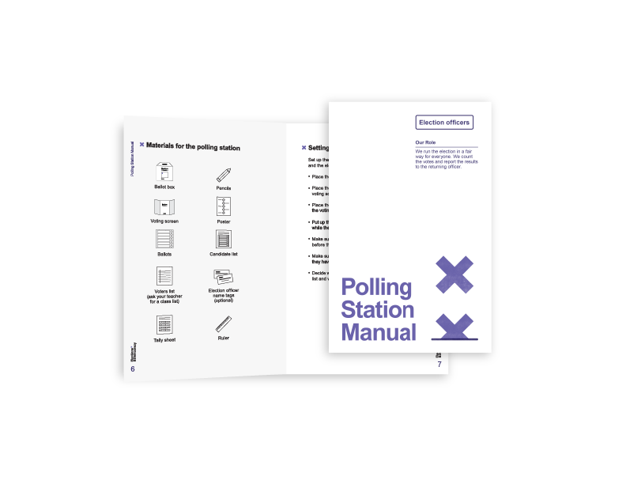
Getting ready
Introduction
Activity
The election officers
Polling Station Manual
Voting materials
Notes:
To begin, have the election officers use the manual to affirm the solemn declaration and do the Does It Count? Activity.

Slide 10
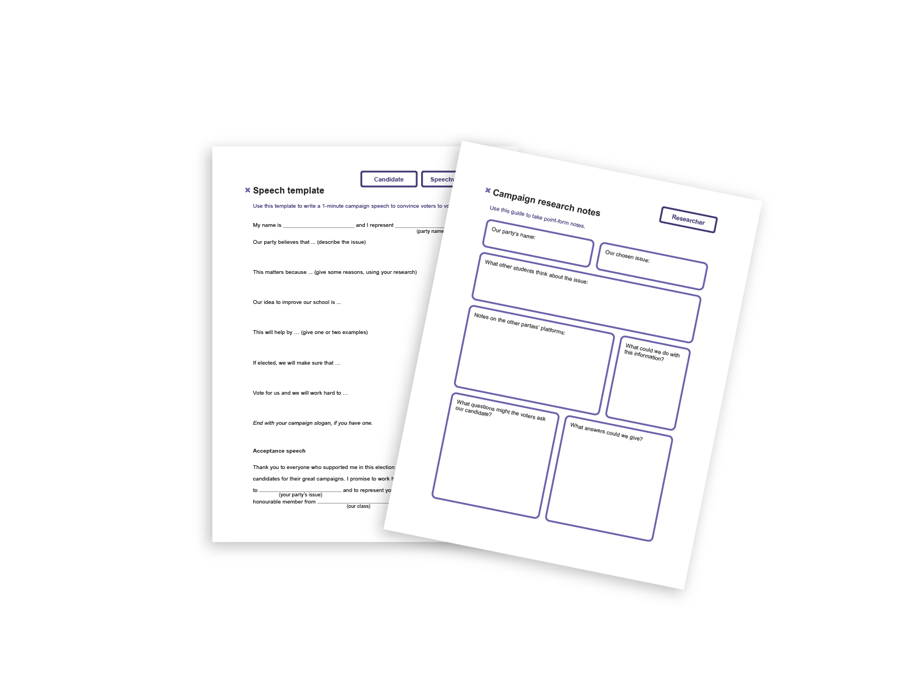
Getting ready
Introduction
Activity
The political party members
Role cards
Speech template
Campaign research notes
Notes:
To begin, have the political members divide the role cards among their group and select a candidate for election.

Slide 11
Preparing the campaign
Activity
You will have 15 minutes to prepare the campaign.
Election officers
Use the Polling Station Manual to help you set up the polling station.
Political party members
Use your role card to help you prepare your campaign.
Notes:
Set a timer so that all students can see it. The time can be expanded if needed, but the activity will then extend longer.
Circulate to assist as needed.
Write a numbered list of the candidates and their political parties on the board to help with the voting process later.
All students are voters: they will need to show their ID before they can vote. Students can show their student ID or you can hand out the optional voter ID cards and have students make their own ID.

Slide 12
Candidates deliver their speeches
Campaigning
Activity
One minute each
Questions from voters
Notes:
Before you begin the campaign, review the classroom norms together. Highlight that students need to keep their questions focused on the issues and proposed solutions.
If you wish to complete the whole activity in one class period, use a timer to limit the questions and answers to 1 minute per candidate.

Slide 13
The ballot is secret
Voting
Activity
You do not have to support your own party or candidate if you feel another has done a better job.
If you are the candidate, you can vote for yourself.
The elected candidate will represent everyone in the class.

Slide 14
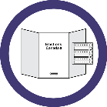
Voting Step by Step
Voting
Activity
Line up and show your ID.
Get your ballot and go behind the voting screen.
Mark the ballot for one candidate.
Fold the ballot and bring it back to the election officer.
Place the ballot in the ballot box.
Congratulations! Your vote counts!
Notes:
Election officers can vote first to demonstrate the process using the poster.
Once all students have voted, election officers count the ballots and report the results to the returning officer (teacher).
After students vote, they collect their exit card and complete it individually while their classmates vote.

Slide 15
Results
Voting
Activity
Results of our election
Acceptance speech by the winning candidate
Notes:
Congratulate all students on their efforts.

Slide 16
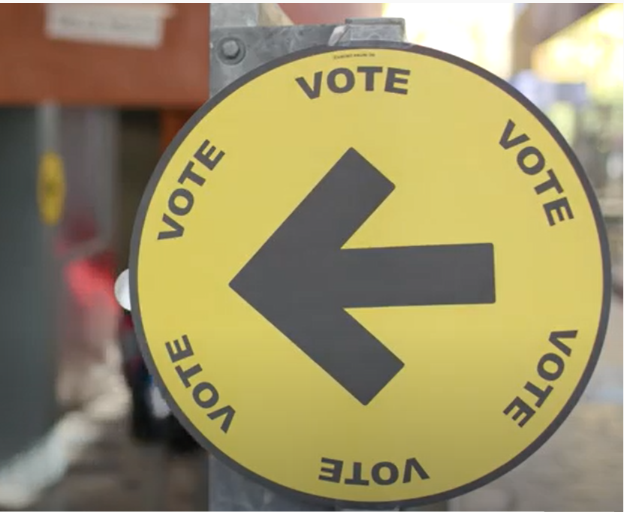
Consolidation
Imagine running an election for the whole population of Canada. How might it be different from or similar to our classroom election?
A Look Back at the 2019 Federal Election
Notes:
After the video have students Turn and Talk with a partner to discuss how the voter’s experience in a federal election is similar to and different from your experience in our classroom election.

Slide 17
Discussion
Consolidation
Do you think our election was fair?
What do you think made it fair or unfair?
How might our election have been different if more students in our school had voted?
Notes:
To maintain a safe and supportive classroom environment, encourage students to focus on the issues and procedures, not on the candidates or other students. For example, you can ask them to think about how the vote was kept secret.

Slide 18
Reflection
Consolidation
What did you learn about your roles in today’s simulation?
Do you think our election was fair? How do you think the process helps to keep the election fair?
What questions do you have now?

