Slide 1
Does Voting Matter?

Slide 2
Inquiry Question
Does Voting Matter?

Slide 3
Minds On
What do I care about?
Raise you hand if you care…
Notes:
Teachers Note: This activity should take only a minute or two; do not spend a lot of time discussing these questions. Your goal is to introduce the big idea that elected officials make decisions that affect all Canadians.

Slide 4
Minds On
Do you care if the government:
changes rules about immigration to Canada?

Slide 5
Minds On
Do you care if the government:
makes it more difficult for seniors to receive the Old Age Security pension?

Slide 6
Minds On
Do you care if the government:
places penalties on businesses that contribute to climate change?

Slide 7
Minds On
Do you care if the government:
joins a military alliance that could lead to war?

Slide 8
Minds On
Do you care if the government:
changes prison terms for serious crimes?

Slide 9
Minds On
Do you care if the government:
removes coins as a method of paying for items?

Slide 10
Minds On
Do you care if the government:
negotiates new agreements with Indigenous people?

Slide 11
Minds On
The Government of Canada makes decisions about each of these matters through our elected members of Parliament.
Whether we realize it or not, and whether we choose to vote or not, many parts of our lives are affected by the decisions of lawmakers.

Slide 12
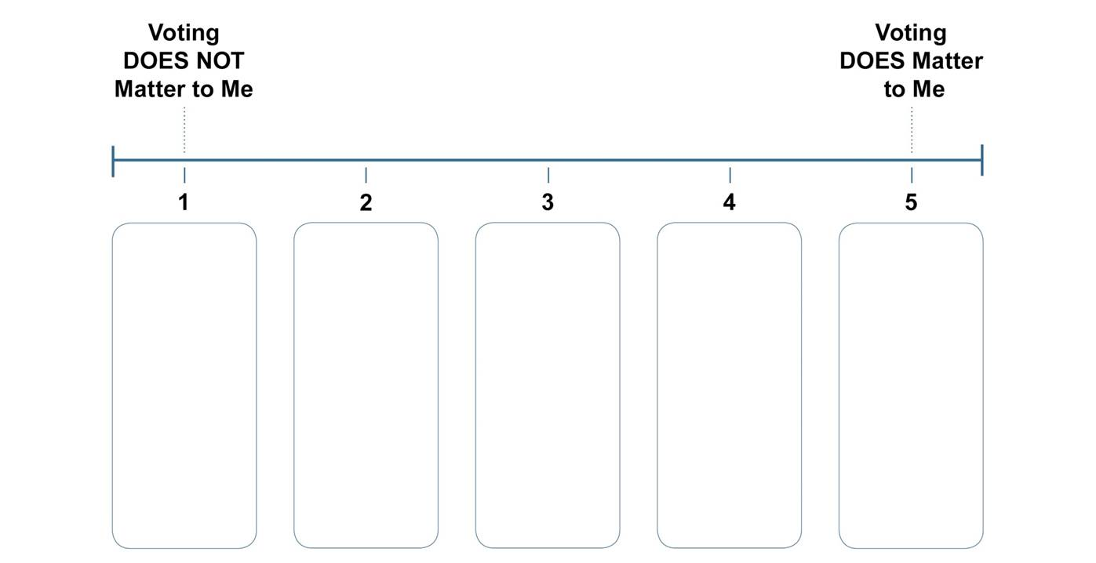
Minds On
Class Poll: Does voting matter to you?
Notes:
Teachers Notes: You can use the dot-voting template provided. You’ll need to enlarge the template or create your own poster using chart paper. Alternatively, you can use a polling app or other online voting tool. Explain that students will revisit the inquiry question “Does voting matter?” at the end of the lesson.

Slide 13
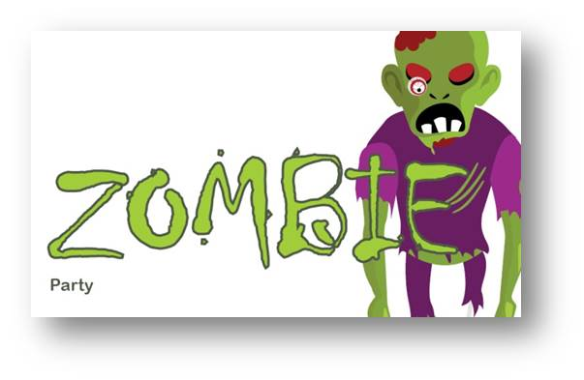
Activity
We will have four rounds of voting.
Voting Simulation
We will elect a new president today.
Notes:
Teachers Notes: Place a campaign sign in each of the four corners of the room.

Slide 14
Activity
Candidates will now read a prepared speech to the class.
Notes:
Teachers Notes: Select four students to represent each of the four parties: Captain’s Party, Dinosaur Party, Wizard Party and Zombie Party. Make sure to select students who are comfortable standing up and reading aloud to the class. If possible, give them a few minutes to read the speeches, especially the end where they have to create a dino call, or walk like a zombie, etc. Encourage students to add their own dramatic and comic flair.

Slide 15
Activity
Captain’s Party Speech
Notes:
Teachers Notes: Show this slide as the Captain’s Party candidate is speaking.

Slide 16
Activity
Dinosaur Party Speech
Notes:
Teachers Note: Show this slide as the Dinosaur Party candidate is speaking.

Slide 17
Activity
Wizard Party Speech
Notes:
Teachers Note: Show this slide as the Wizard Party candidate is speaking.

Slide 18
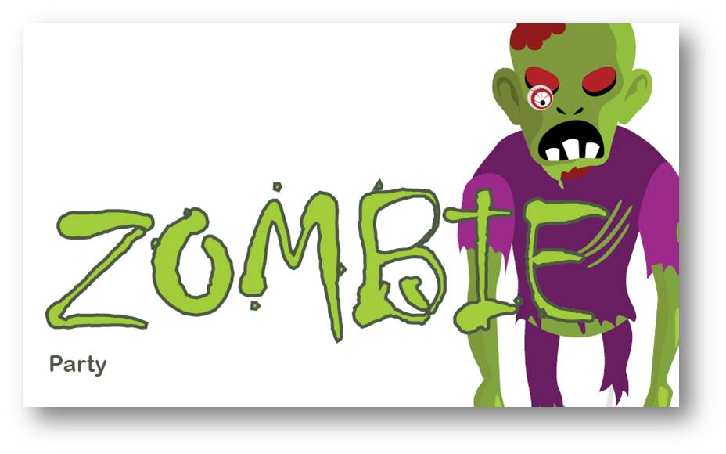
Activity
Zombie Party Speech
Notes:
Teachers Note: Show this slide as the Zombie Party candidate is speaking.

Slide 19
Activity
Round 1 – Free vote
Go to the corner of the room featuring the party of your choice.
If you choose not to vote, remain seated.

Slide 20
Activity
Round 1 – Results
Everyone must do the activity of the winning candidate’s party platform.
How did the outcome of the vote affect you?
Notes:
Teachers Notes: E.g. make a dino call, or move like a zombie

Slide 21
Activity
Round 2 – Low Voter Turnout
Only five students may vote.
If you were not selected to vote, remain seated.
Notes:
Teachers Note: Choose a random method of assigning voter turnout in this scenario, e.g. cards or seating position. Ties should be broken by a coin toss or other tie breaker.

Slide 22
Activity
Round 2 – Results
Everyone must do the activity of the winning candidate’s party platform.
For voters: How did your vote affect the election?
For non-voters: How did you feel about not being able to participate?

Slide 23
Activity
Round 3 – 50% turnout
Half the students may vote.
If you were not selected to vote, remain seated.

Slide 24
Activity
Round 3 – Results
Everyone must do the activity of the winning candidate’s party platform.
How did the outcome of this vote compare to the previous two votes?
How might the outcome have been different if the other half of the class had voted?

Slide 25
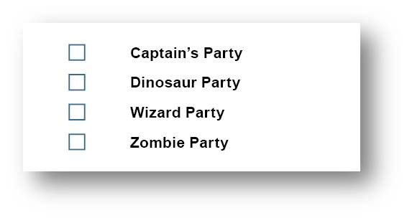
Activity
Round 4 – Secret Ballot
Mark your ballot in secret.
All students may vote if they wish.
If you vote for more than one party, your vote will be spoiled and will not be counted.

Slide 26
Activity
Round 4 – Results
Everyone must do the activity of the winning candidate’s party platform.
How was the outcome of the election the same as or different from the first vote?
Did you vote differently knowing that your ballot was secret? Why or why not?
Does voting matter? Explain your answer.

Slide 27
Activity
Impact in Real Life
Voting (or not voting) can affect the outcome of an election.
In real life, the decisions that elected officials make affect the lives of millions of people, whether they voted or not.

Slide 28
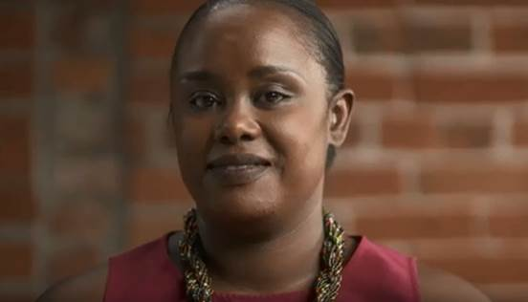
Activity
Does Voting Matter?
Marie-Claire’s Story

Slide 29
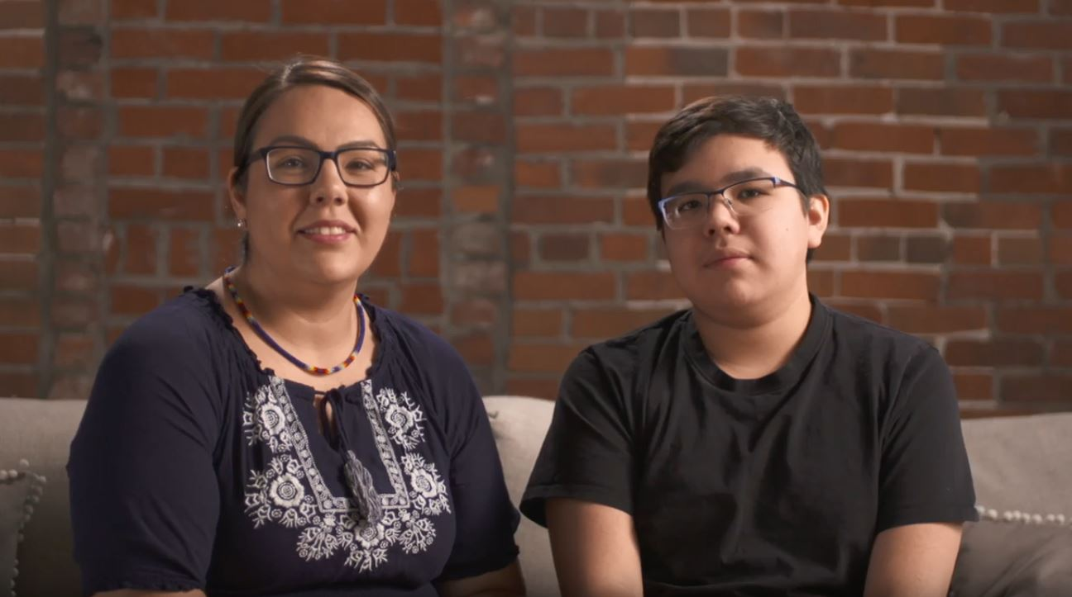
Activity
Does Voting Matter?
Marcie’s Story

Slide 30
Activity
Does Voting Matter?
Did voting have an impact on her life?
How have her experiences influenced her attitudes towards democracy and voting?
How would she answer the question: "Does voting matter?"

Slide 31
Consolidation
Class Poll: Does voting matter to you?
Notes:
Teachers Notes: If you are using the dot-voting template, use a new colour of dot or marker so you can compare the two polls.

Slide 32
Consolidation
Class Poll
What do you notice about your poll?
What do you wonder about?
Did our opinions change?

Slide 33
Consolidation
Reflection
One thing I learned is…
One question I have now is…
One action I will take as a result of this learning activity is…
Notes:
Teachers Notes: You can use the provided Exit Card handout which has these questions printed on it.

