Slide 1
Digital Skills for Democracy

Slide 2
Inquiry Question
How can we find out if information about elections or political issues is something we can trust?

Slide 3
Minds On
True or false?
Shakespeare invented the name “Jessica.”
Answer: True.

Slide 4
Minds On
True or false?
Hippo milk is blue.
Answer: False. It is pink.

Slide 5
Minds On
True or false?
Mammoths were still alive when the Egyptians built the Great Pyramid of Giza.
Answer: True.

Slide 6
Minds On
True or false?
Scientists have found 100,000 golf balls in Loch Ness.
Answer: True.

Slide 7
Minds On
True or false?
The Canadian Space Agency invented the Dust Buster vacuum cleaner.
Answer: False.

Slide 8
Minds On
True or false?
The first owner of the Mona Lisa hung it in his bathroom.
Answer: True.

Slide 9
Minds On
True or false?
Sonic the Hedgehog’s middle name is Maurice.
Answer: True.

Slide 10
Minds On
True or false?
The magnetic field at Magnetic Hill, New Brunswick makes cars roll uphill.
Answer: False. An optical illusion makes it look like cars are rolling uphill when they are actually rolling downhill.

Slide 11
Minds On
True or false?
All kangaroos are left-handed.
Answer: Mostly true. Grey and red kangaroos, the two largest species, are nearly all left-handed.

Slide 12
Minds On
How well did you do at guessing?
Was there any way to tell the true facts from the false ones?

Slide 13
Minds On
It can be difficult to figure out if things are true or false without doing more research.
When we are judging online content, we can’t just “trust our gut” or rely on our own instincts.

Slide 14
Minds On
There are two kinds of false information online:
Misinformation: When people share something they think is true but isn’t.
Disinformation: When people share false or misleading information on purpose.

Slide 15
Minds On
Five digital strategies:
Find the original.
Verify the source.
Check other information.
Read fact-checking articles.
Turn to places you trust.
Notes:
[Teacher’s notes: Give the students the Five Digital Strategies handout and review the five strategies together. Point out that we must follow these steps when we get information about politics or elections online. This information can influence how we make important civic choices, including voting.]

Slide 16
Activity
Round 1 – Fictional scenarios
Notes:
[Teacher’s note: These are possible scenarios where you might need to verify information about a political issue or about the election process in Canada.]

Slide 17
Activity
Round 1 – Fictional scenarios
Getting Ready
Your group will need:
the Five Digital Strategies handout
the graphic organizer
round 1 scenario cards
Notes:
[Teacher’s notes: You can assign students roles within their teams, such as card master, recorder, reporter and reader. You can give out the cards one at a time, or give them all to the student who is designated as the card master. Keep the answer card until the end.]

Slide 18
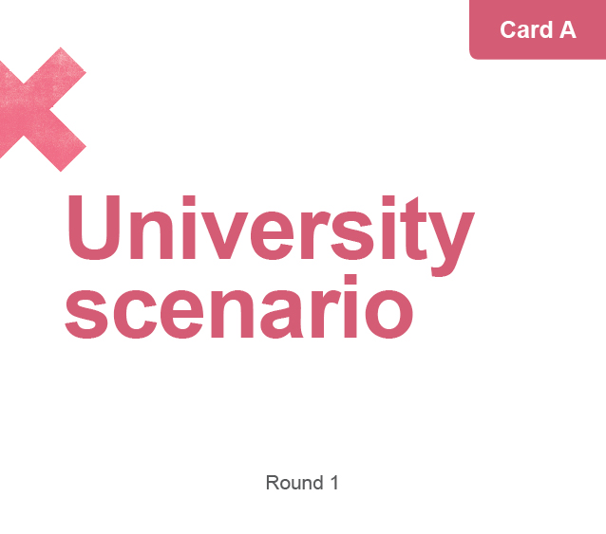
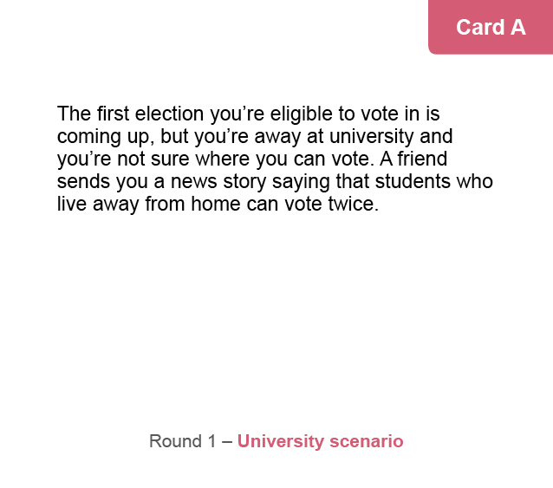
Activity
Round 1 – Fictional scenarios
Read scenario card A aloud.
Discuss the scenario and decide how trustworthy it is.
Record your thinking on the graphic organizer.
Notes:
[Teacher’s note: If students would find it helpful, model one scenario for the class before teams begin their work.]

Slide 19
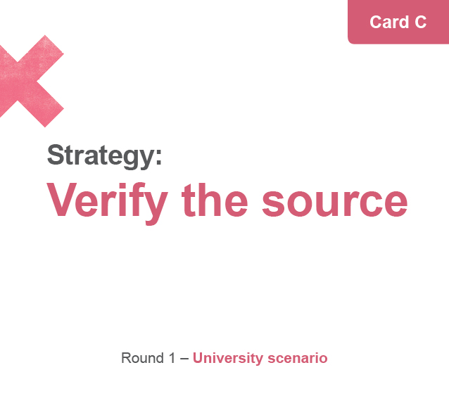
Activity
Round 1 – Fictional scenarios
Read strategy cards B, C and D aloud.
Discuss and consider: Does the card change the trustworthiness ranking of the scenario?
Record your thinking on the graphic organizer.

Slide 20
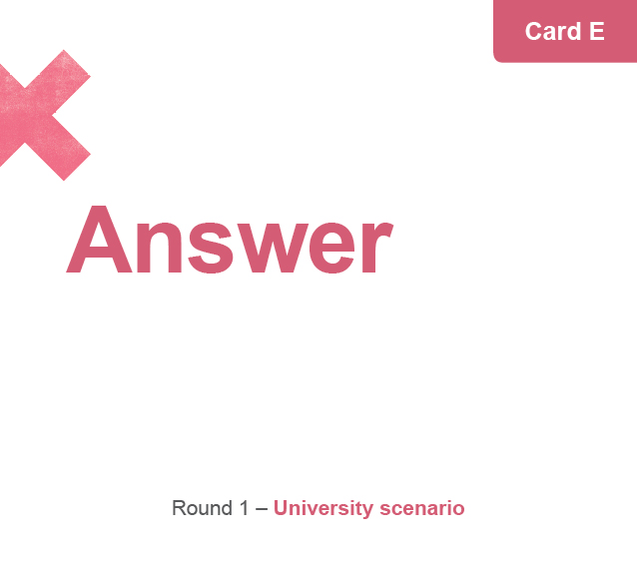
Activity
Round 1 – Fictional scenarios
Read answer card E aloud.
Discuss and consider: What is your final ranking of the scenario? Why?
Record your thinking on the graphic organizer.

Slide 21
Consolidation
Share your thinking:
Read scenario card A to the class.
Our final trustworthiness ranking is…
The strategy we found the most helpful was…
Notes:
[Teacher’s note: If students are struggling to read the scenarios aloud, you can use the teacher summary page in the teacher guide to help clarify the information for the class.]

Slide 22
Activity
Round 2 – Real-life scenarios
Notes:
[Teacher’s note: Each scenario is based on real-life examples of political or election information that people have had to evaluate online.]

Slide 23
Activity
Round 2 – Real-life scenarios
Getting Ready
Your group will need:
the Five Digital Strategies handout
the graphic organizer
round 2 scenario cards
Notes:
[Teacher’s notes: You can assign students roles within their teams, such as card master, recorder, reporter and reader. You can give out the cards one at a time, or give them all to the student who is designated as the card master. Keep the answer card until the end.]

Slide 24
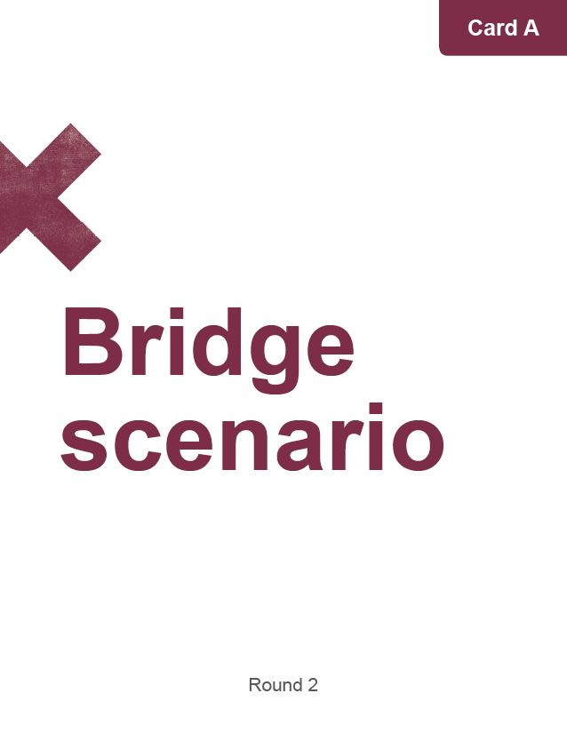
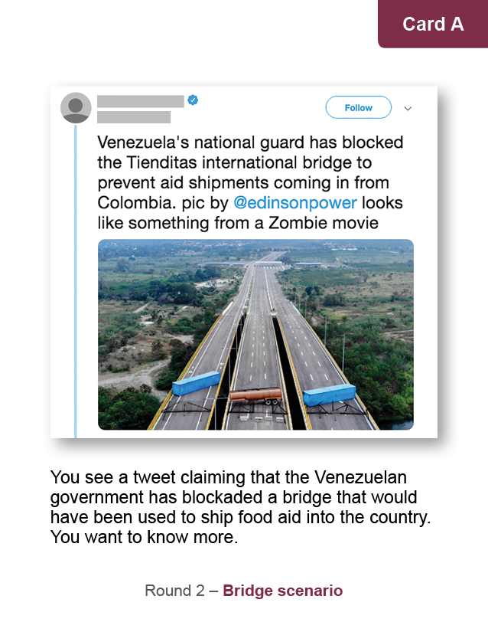
Activity
Round 2 – Real-life scenarios
Read scenario card A aloud.
Discuss the scenario and decide how trustworthy it is.
Record your thinking on the graphic organizer.

Slide 25
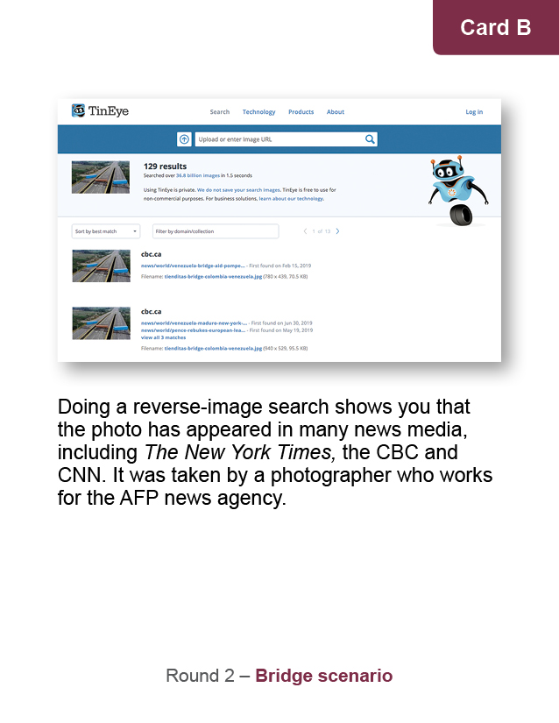
Activity
Round 2 – Real-life scenarios
Read strategy cards B, C and D aloud.
Discuss and consider: Does the card change the trustworthiness ranking of the scenario?
Record your thinking on the graphic organizer.

Slide 26
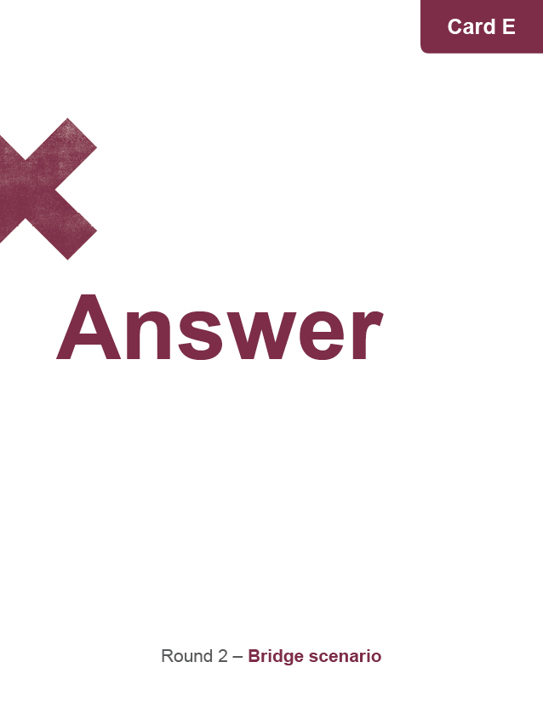
Activity
Round 2 – Real-life scenarios
Read answer card E aloud.
Discuss and consider: What is your final ranking of the scenario? Why?
Record your thinking on the graphic organizer.

Slide 27
Consolidation
Share your thinking:
Read scenario card A to the class.
Our final trustworthiness ranking is…
The strategy we found the most helpful was…
Notes:
[Teacher’s note: If students are struggling to read the scenarios aloud, you can use the teacher summary page in the teacher guide to help clarify the information for the class.]

Slide 28
Consolidation
Discuss:
What do you think is the best way to respond to false or misleading information online?
What surprised you the most about the activity?
How do you think misinformation and disinformation could affect our elections?
Notes:
[Teacher’s notes: It is our responsibility to detect misinformation and disinformation and help keep it from spreading by not sharing or “liking” it. This is especially important in an election period, when false or misleading information could influence the way people vote.]

Slide 29
Consolidation
Reflection:
One thing I learned is…
The next time I want to find out if something online is true, I will…
To be an engaged and informed citizen in a democracy, it’s important to…
Notes:
[Teacher’s note: You can use the Exit Card handout on which these questions are printed.]

