Slide 1
Voting Rights through Time

Slide 2
Inquiry Question
How inclusive is our democracy?

Slide 3
Minds On
Think of a time when you felt excluded from something.
How did that feel?
What did you do?
Notes:
Teacher’s Notes: Don’t ask for specific details of the event, just the emotions and actions. Distribute 1-2 sticky notes to each student and have students write down their feelings and experiences on them.

Slide 4
Minds On
Think of a time when you felt included in something.
How did that feel?
What did you do?
Notes:
Teacher’s Notes: Don’t ask for specific details of the event, just the emotions and actions. Distribute 1-2 sticky notes to each student and have students write down their feelings and experiences on them.

Slide 5
Minds On
What does Inclusion look like/feel like?
What does Exclusion look like/feel like?
Notes:
Teacher’s Notes: Collect the sticky notes on the board or on chart paper. Read out some of the words in each category. Discuss what inclusion and exclusion feel like and look like, and come up with criteria as a class. This will help guide students’ decision-making during the activity.

Slide 6
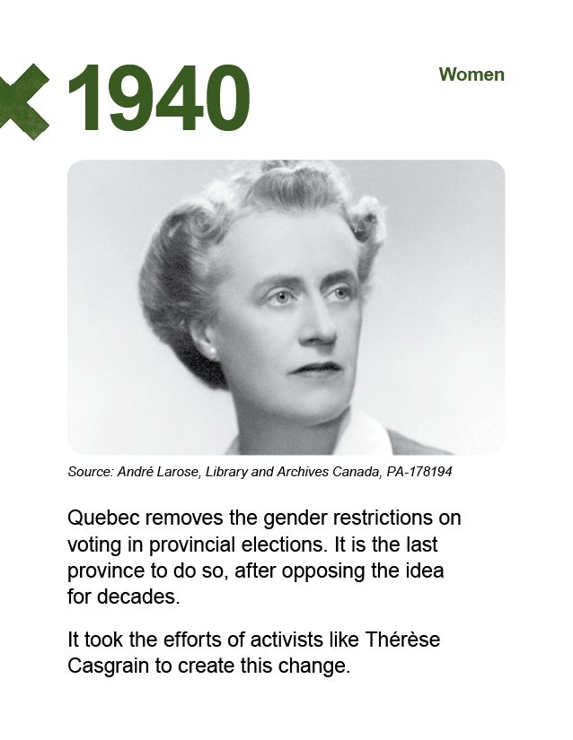
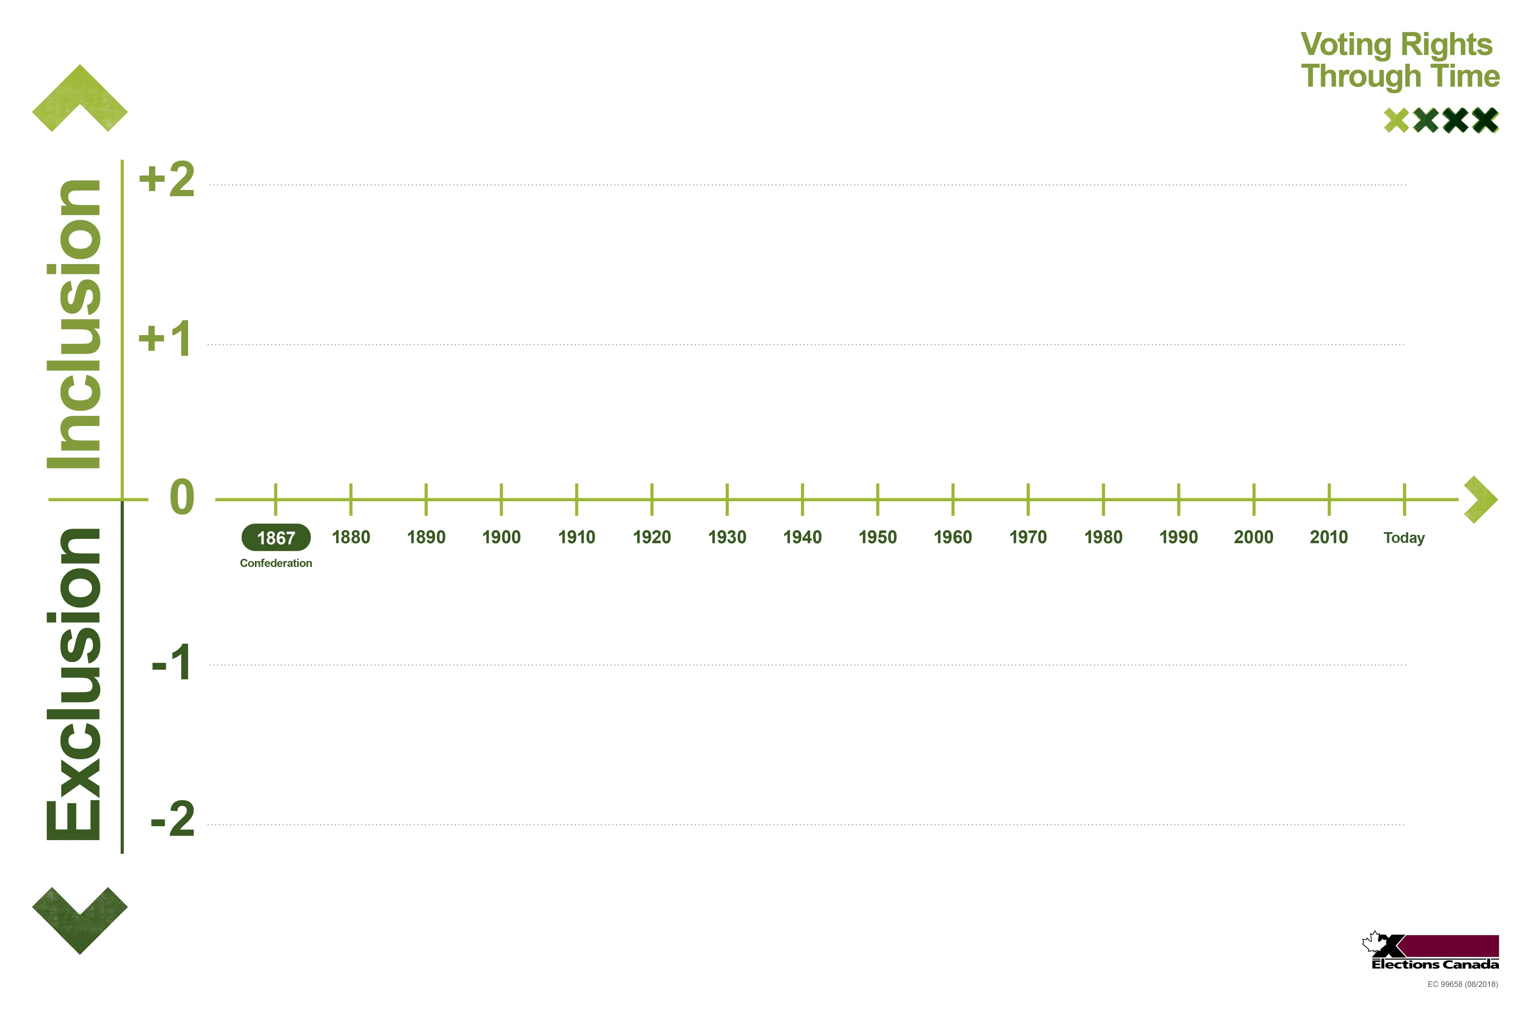
Activity
Get ready for your case study
Each group needs:
A timeline activity board
A set of case study cards: the context card and associated activity cards
Notes:
Teacher’s Notes: Place students in small groups and distribute the materials. You can also distribute the Turning Point frame at this point, if you are using it. Explain that each set of cards illustrates a historical case study related to the right to vote in Canada.

Slide 7
Activity
Read aloud your context card before you begin.
Notes:
Teacher’s Notes: Give each group a context card to read aloud together.

Slide 8
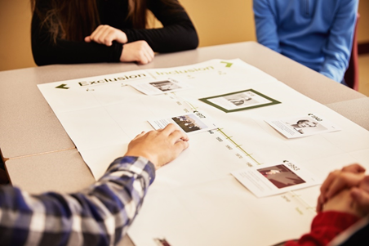
Activity
Read aloud your case study cards.
Place each card on the timeline by date.
Discuss as a group where you will place the card on the Inclusion/ Exclusion scale.
Notes:
Teacher’s Notes: Note that there are no right answers in this activity, and every group’s timeline will look different. The discussions and reasoning are the most important part.

Slide 9
Activity
Turning point:
When the process of change shifts in direction or pace.
Was there a turning point in your case study?
Place your Turning Point Frame on your timeline.
Notes:
Teacher’s Notes: This is an optional part of the activity to discuss the concept of a Turning Point, which is part of the historical thinking concept Continuity and Change. This is not always the same as Historical Significance, another historical thinking concept. You may wish to skip this step.

Slide 10
Activity
Share your thinking.
What was the most difficult card to place?
Which events were surprising to you?
Which events do you have questions about?
Notes:
Teacher’s Notes: Students will need to see each other’s case study timelines. Choose the suggested activity that will work for your learners: quick share, gallery walk, walking jigsaw or station rotation Text is from the updated teachers’ guide.

Slide 11
Consolidation
Discussion:
Does getting the right to vote always mean inclusion in democracy?
Are other changes needed to make Canada’s democracy more inclusive?
Notes:
Teacher’s Notes: Use the background information from the teacher’s guide to address any misconceptions or false inferences that have been brought up so far.

Slide 12
Consolidation
Watch the video: Voting Rights Through Time

Slide 13
Consolidation
The Right to Vote in Federal Elections: Then and Now
Notes:
Teacher’s Notes: Distribute copies of the infographic “The Right to Vote in Federal Elections: Then and Now.” Read aloud the text first before asking the questions.

Slide 14
Consolidation
What do you notice about federal voting rights in 1867?
What questions do you have?
Notes:
Teacher’s Notes: Read aloud the text first before asking the questions.

Slide 15
Consolidation
What do you notice about federal voting rights today?
What questions do you have?
Notes:
Teacher’s Notes: Read aloud the text first before asking the questions.

Slide 16
Consolidation
Reflect individually.
What surprised you about inclusion and exclusion in Canadian democracy?
What is one question you have now?
Are other changes needed to make Canada’s democracy more inclusive?
Notes:
Teacher’s Notes: These questions are printed on the Thinking Guide handout if you are using it.

