Slide 1


Geography
of Elections

Slide 2

Inquiry Questions
What is my federal
electoral community? How does it compare to others?

Slide 3
Minds On
Turn and Talk
What communities are you a part of?
Notes:
Teacher’s note: If students are stuck, prompt them to think about their school community, neighbourhood, city, cultural group(s), faith community, online communities, sports teams, etc.

Slide 4
Minds On
Did you know that you are part of a community that elects a representative to Parliament?
It’s called an:
Electoral District
or a
Riding
or a
Constituency
Notes:
Teacher’s note: You may want to ask if students know who their federal representative to Parliament is, to help them make the connection.

Slide 5
Activity
We will be examining maps to help us understand:
What is my electoral community?
How does it compare to others?

Slide 6
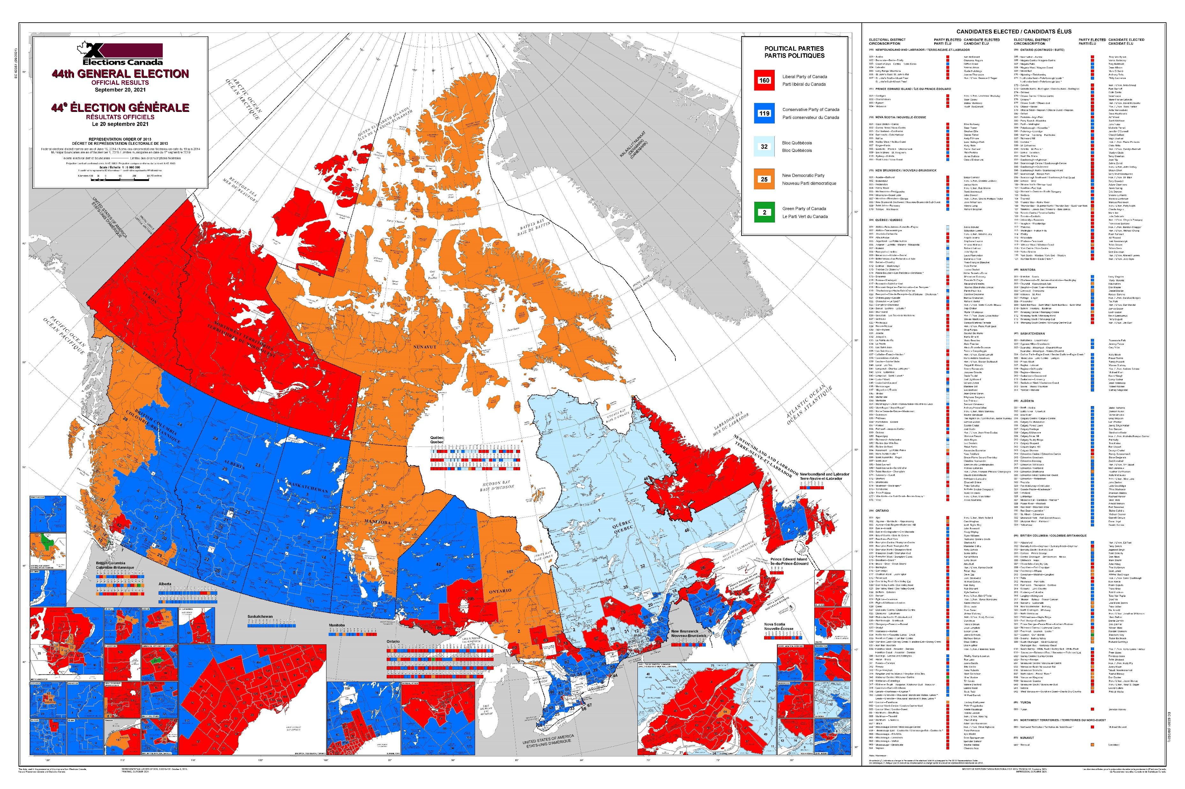
Activity
Map Literacy
What is the purpose of this map?
Who published it?
What does this map show?
What does this map not show?
Does anything surprise you?
Notes:
Teacher’s note: Divide your class into groups, and have them switch maps after a few minutes so that they can look at both large maps. You may wish to give each group a few sticky notes to label the map features.

Slide 7
Activity
Map Literacy
Where is our electoral district?
What do you notice about our electoral district?
Notes:
Teacher’s note: Invite students to place a sticky note or pin on the large map(s) indicating your school’s electoral district.

Slide 8
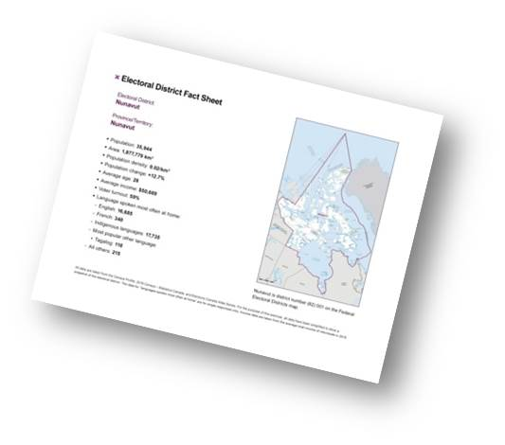
Activity
Examining our Electoral District
In your small group, read aloud your fact sheet.
Which facts are surprising or unique?
Which facts do you have questions about?
How do you think our electoral district will
compare to others?

Slide 9
Activity
Finding Other Electoral Districts
Find your new electoral district on the large maps.
Show us where it is!
Notes:
Teacher’s note: Distribute a new fact sheet from a different electoral district to each group. We recommend that each group examine a different fact sheet to allow for a richer discussion in the consolidation phase. You can invite students to show where the new district is with a sticky note or a pin.

Slide 10
Activity
Examining Another Electoral District
In your small group, read aloud your new fact sheet.
Which facts are surprising or unique?
Which facts do you have questions about?
How does it compare to our electoral district?

Slide 11
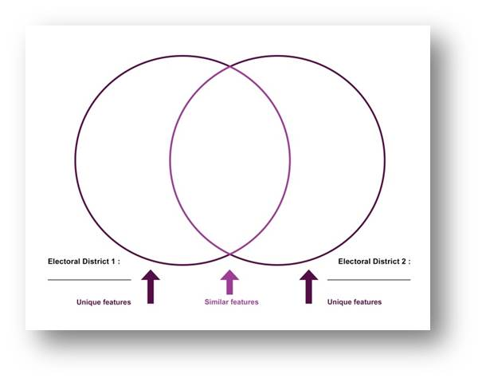
Activity
Comparing Electoral Districts
Complete the comparison chart with your group.
Place similar features in
the middle section
Place different features in
the outer sections
Notes:
Teacher’s note: Distribute one handout to each small group. You may need to clarify that things should be similar, but don’t need to be exactly the same, to go in the centre of the diagram.
Also, students do not need to put all the information on the diagram, but can select three to five facts that show the uniqueness of each district.

Slide 12
Consolidation
Comparing Electoral Districts
Share with the class:
One or two interesting or surprising similarities
and differences.

Slide 13
Consolidation
Class Discussion
Do you know:
How many people these districts each send to Parliament?
Of the two districts you compared, which one is the easiest to represent? Why?

Slide 14
Consolidation
Reflection
What new information did you learn to answer
the inquiry question:
- What is my electoral community?
How does your electoral community compare to others?
One thing I learned is…
One question I have now is…
Notes:
Teacher’s note: You can use the provided exit card handout which has these questions printed on it.

