Slide 1


Elections by
the Numbers

Slide 2

Inquiry question
How does youth
voting compare to that
of other age groups?

Slide 3
Minds on
Trends
What are some trends in our school
or community?
Notes:
Teacher’s note: e.g. fashion, games, music. For this and the next few slides, gather students’ ideas and write them on the board or shared document.

Slide 4
Minds on
Trends
Do you think there are different trends for
different age groups? Why?
Notes:
Teacher’s note: e.g. you, your parents, your grandparents.

Slide 5
Minds on
Trends
How do you know if something is on its way out
or way in?

Slide 6
Minds on
Trends
How could you track these trends in a more
precise or mathematical way?
Notes:
Teacher’s note: e.g. through a survey, poll, observation, etc.

Slide 7
Minds on
Voting trends
What do you think could be some trends in
voting behaviour?
Do you think there are different voting trends for different age groups? Why?
How might you compare voting trends for different
age groups?
Notes:
Teacher’s note: Write some of these ideas on the board or shared document so that students can compare the two sets of ideas.

Slide 8
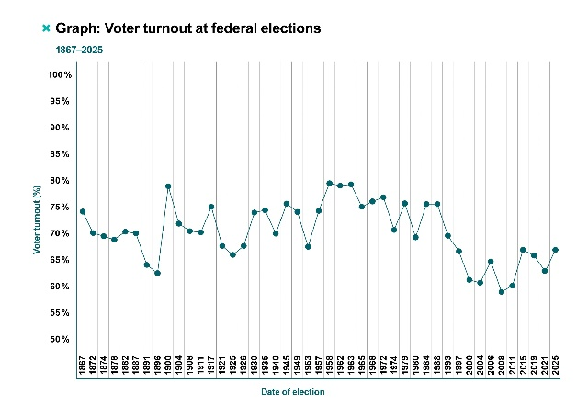
Activity
Analyze a graph
What information is included in the graph?
What information is not included?
What can we observe in the graph?
What can we conclude from this graph?
Notes:
Teacher’s note: Distribute copies of the graph “Voter turnout at federal elections 1867–2025” and have students discuss these questions in pairs or small groups.

Slide 9
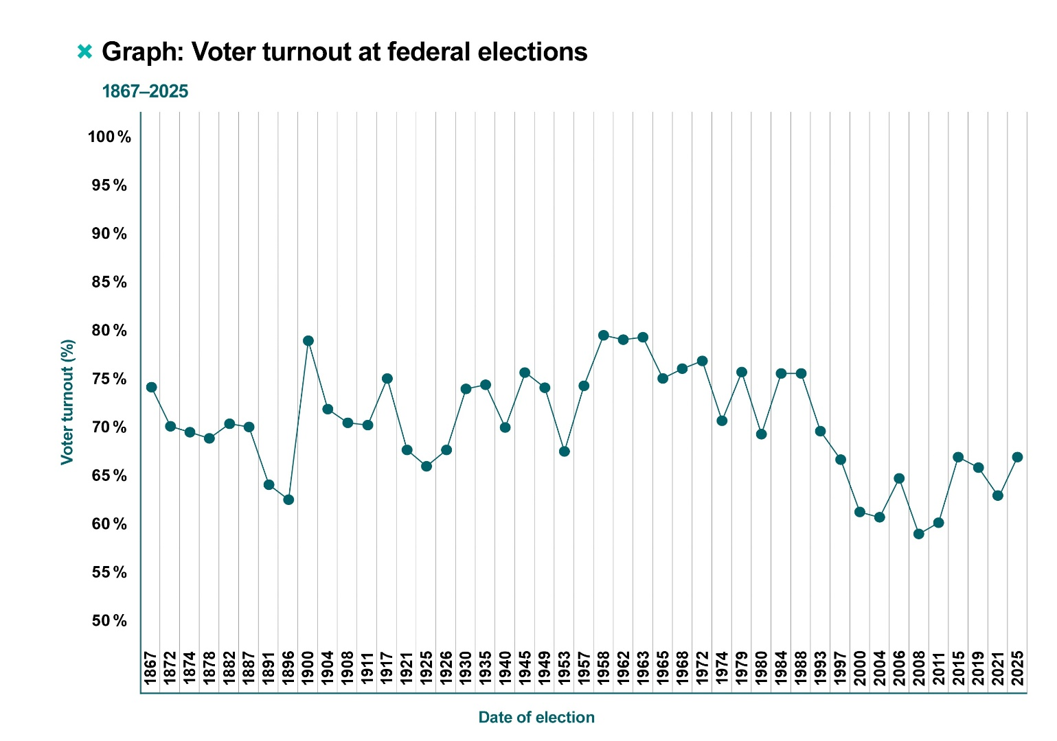
Activity
Voter turnout at federal elections, 1867–2025

Slide 10
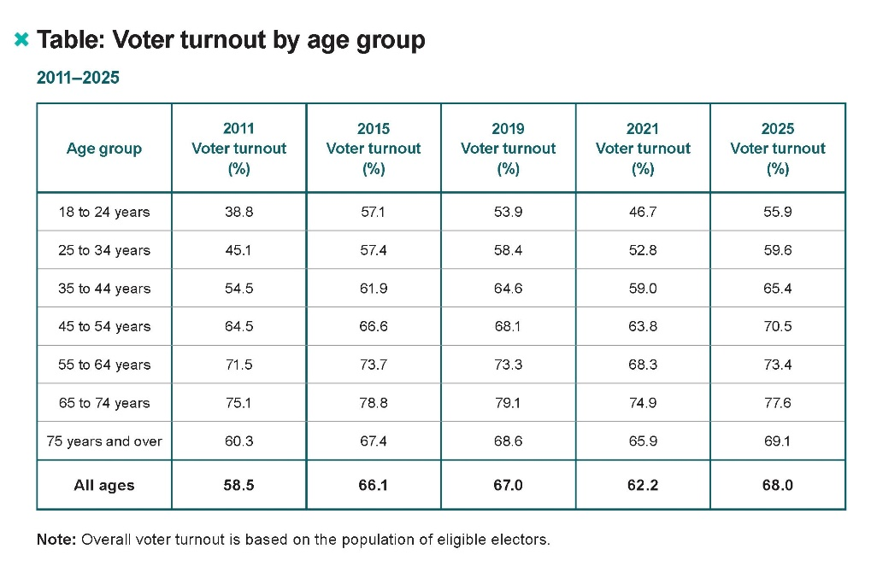
Activity
Examine the data table, “Voter turnout by age group, 2011–2025”
How does youth voting compare to that of other
age groups?

Slide 11
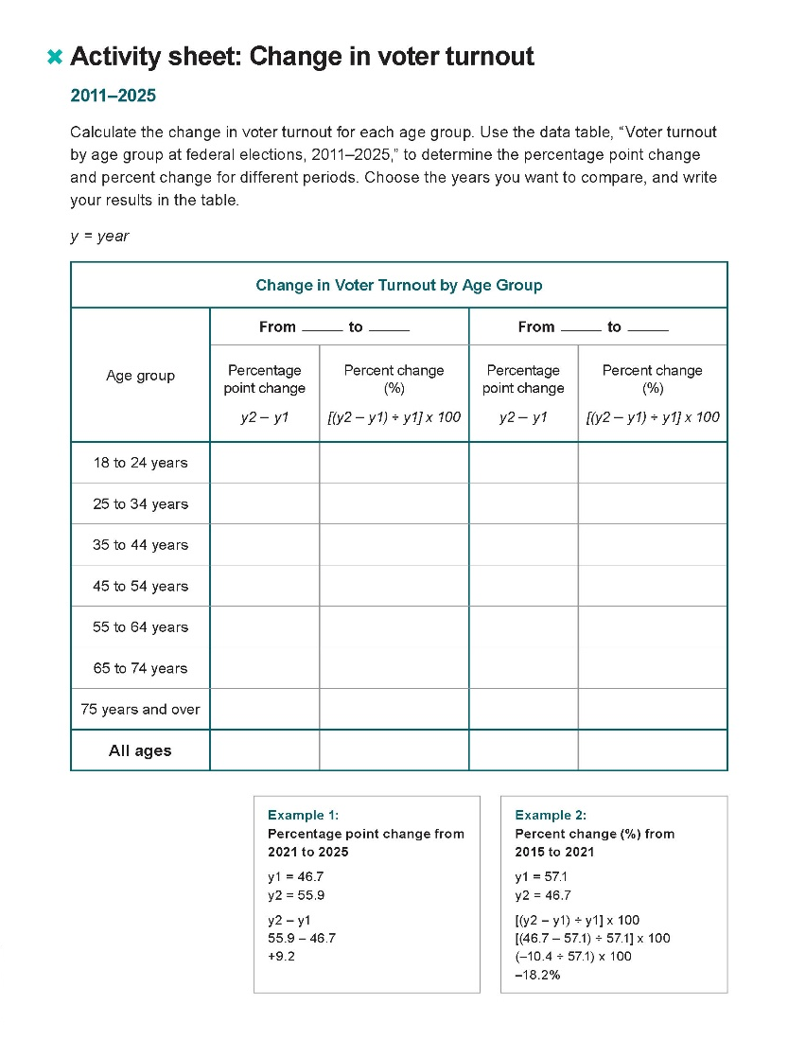
Activity
Complete the activity sheet, “Change in voter turnout,” to better understand the data.
How does this change your thinking about the data?
How might you choose to represent it?
Notes:
Teacher’s note: If calculating percent change is too advanced for students, they can create their visual representation using only the table data.

Slide 12
Activity
You will need:
A partner or small group
Chart paper or whiteboard
Markers
Table: Voter turnout by age group – 2011-2025
Activity sheet: Change in voter turnout

Slide 13
Activity
Brainstorm an effective way to represent this data to respond to the inquiry question:
How does youth voting compare to that of
other age groups?
Show us your best idea!
Notes:
Teacher’s notes: Students can create any kind of graph, chart, image or infographic that supports your learning goals. This should be more conceptual rather than an attempt to create a polished finished product. Give students 20 to 30 minutes to work together on this.

Slide 14
Consolidation
Sharing your ideas
How did you address the question:
How does youth voting compare to that of other age groups?
What information did you choose to include
or exclude?
Notes:
Teacher’s notes: This could be done in a jigsaw, a gallery walk or a group presentation to the class. If time is short, you could choose a couple of samples to discuss and share.

Slide 15
Consolidation
Discussion
Why do you think different age groups vote at different rates?
What are some factors that could affect voter
turnout for different age groups?

Slide 16
Consolidation
Reflection
What is interesting or important to you about the data on youth voting?
- Explain your thinking
Make a prediction about an election 10 years from now. Do you think voting among 18–24 year-olds will increase, decrease or stay the same?
- Explain your thinking
Notes:
Teacher’s note: You can use the provided exit card on which these questions are printed.

