Slide 1




Mapping
Electoral
Districts

Slide 2
Minds on
Imagine:
You are at a family party to celebrate a
grandparent’s birthday.

Slide 3
Minds on
There are seven people at the party:
One grandparent
Two adults
Three teenagers
One 3-year-old
How would you divide the cake so that everyone gets their fair share?
Notes:
Teacher’s note: You can prompt students with additional questions. Examples: “Should everyone get the same-sized piece?” and “Should the cake be divided based on age, size or other factors?”

Slide 4
Inquiry question
What makes an electoral district fair?

Slide 5
Activity
Did you know?
Canada is divided into hundreds of electoral districts.
In each district, voters elect one member of Parliament to represent everyone who lives there.
To reflect changes in the Canadian population,
the number of electoral districts is adjusted every 10 years.

Slide 6
Activity
When deciding on new boundaries, we consider:
The size of the population
Geographic features
Social factors, such as culture and language

Slide 7
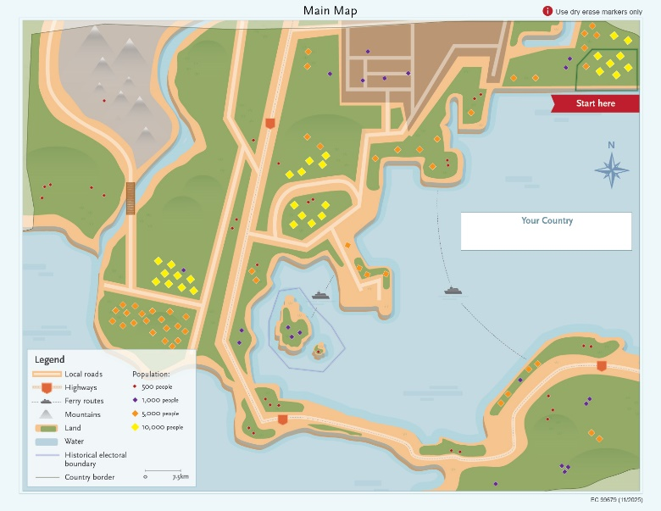
Activity
Getting ready
Your group will need:
One Main Map
Two reference maps
  Language Communities
  Shared History
One handout: Instructions for students
Dry erase markers

Slide 8
Activity
Your task:
Draw the electoral boundaries for an
imaginary country.

Slide 9

Activity
Start by naming your country.

Slide 10
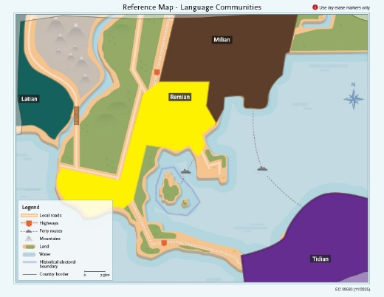
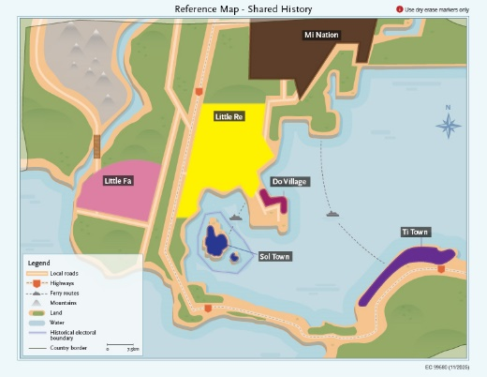
Activity
Use the reference maps to create eight electoral districts on the Main Map.
Use dry-erase markers only.
One district is already created.

Slide 11
Activity
Guidelines:
Aim for a similar number of people in each district
Use the reference maps to guide your decisions
You can create more than eight districts, but you must explain why
Notes:
Teacher’s notes: Allow 20 to 30 minutes for the activity. Remind students to consider geographic features, population, language and shared history.

Slide 12
Consolidation
Share your thinking:
post your group’s map.
explain your thinking.
Notes:
Teacher’s notes: We suggest a gallery walk where you display each of the Main Maps in the classroom and divide each group into two subgroups. One subgroup stays with their map to explain their decision making in drawing their boundaries, and the other visits the maps of the other groups. Halfway through, have the subgroups switch.

Slide 13
Consolidation
Discussion:
What similarities and differences do you see?
What changes would you make to your map?

Slide 14
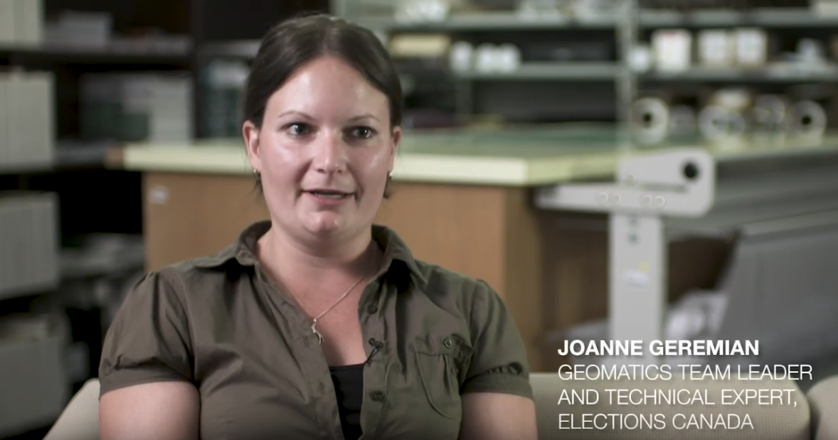
Consolidation
Interview with an Elections Canada geographer

Slide 15
Consolidation
Return to the inquiry question:
What makes an electoral district fair?

Slide 16
Consolidation
Reflection:
I think that the most important factor in making electoral districts fair is... This factor is important because…
It is important to make electoral districts fair because…
One question I have now is…
Notes:
Teacher’s note: You can use the provided Exit card handout, on which these questions are printed.

